Slide 1
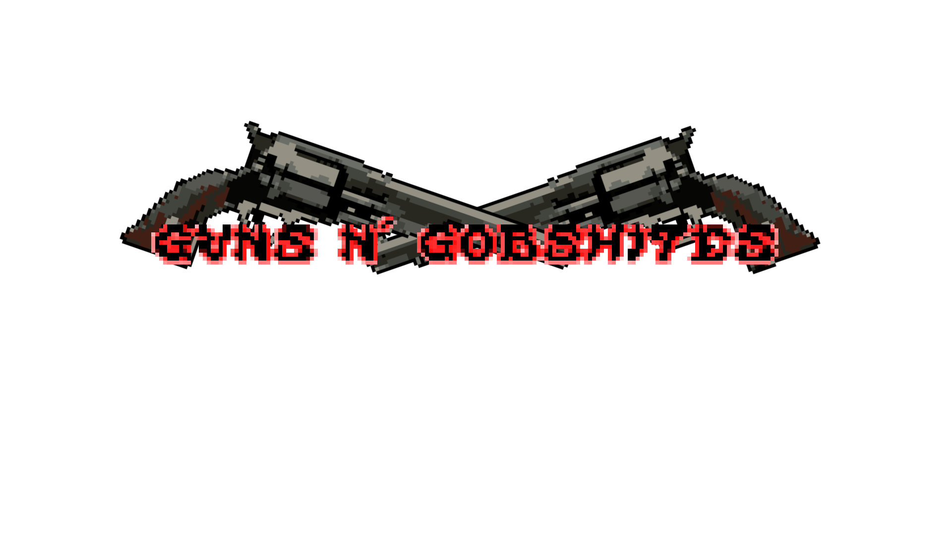
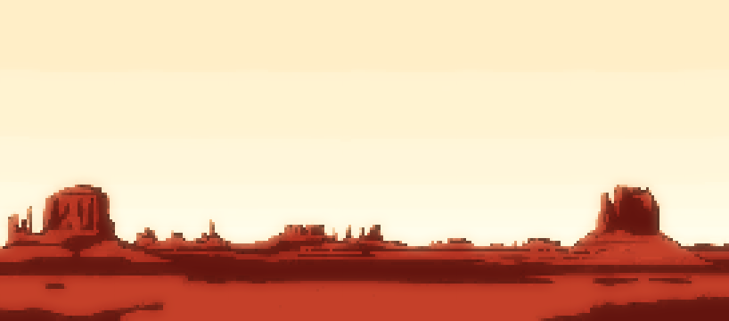
Game Design Document
Group 5( Mark, Robert, Steven, Cathal and Mohammad)

Slide 2
Table of Contents
- Introduction/Overview
Game Mechanics
A.I.
Game Elements
Story Overview
Game Progression
Graphic User Interfaces
Guns N’ Gobshites

Slide 3
Introduction
- The type of game we will be trying to make is like that of other entries into the platformer shooter such as Ghosts and Goblins by capcom and the Commando Games by Miniclip.com.
- The game should have a haunted, whacky west like theme that doesn't take itself too seriously, with the premise of the game and the progression making fun out of game loops whilst itself also being a game loop.
- And while the game will not have a large amount of replay ability it should be an enjoyable one-time experience
Guns N’ Gobshites

Slide 4
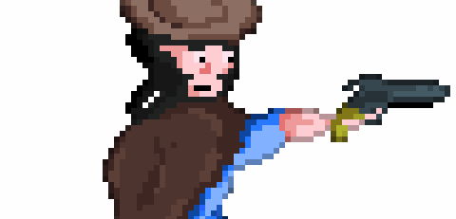
Game Story
Guns N’ Gobshites

Slide 5
Story Overview
-The story will tell the tale of a western hero by the name of Senior H who is sitting by a campfire minding his own business when suddenly someone swoops the pint out of his hand (The "gobshite").
-SeniorH is catapulted reluctantly into action as he tries to retrieve his pint from the main enemy of the game king Dej
Guns N’ Gobshites

Slide 6
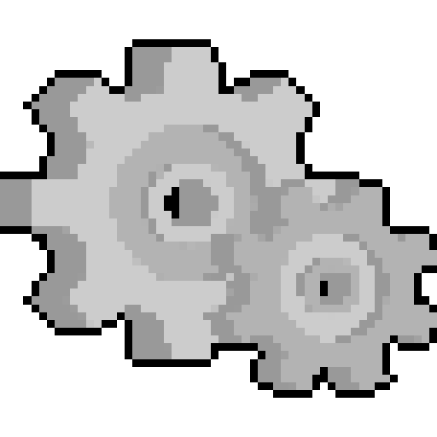
Game Mechanics
Game Elements
Guns N’ Gobshites

Slide 7
Game Mechanics
Our game will contain basic movement mechanics such as moving left, right, jumping and an attack.
Throughout each level there will be new ememies, moving platforms and jumping sections as well as some bosses and mini-bosses with well thought out attack patterns that will challenge the player
The game will also contain hidden weapons in the game which the player will have to achieve by finding them within the game.
Guns N’ Gobshites

Slide 8
Game Elements
In the game there will be the ability to increase your lives by picking up pints and climbing ladders up to different platforms
We will also have various powerups scattered across the maps to aid the player
At the end of each level a boss fight will Occur which should challenge the player.
Guns N’ Gobshites

Slide 9
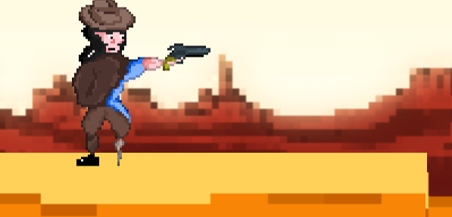
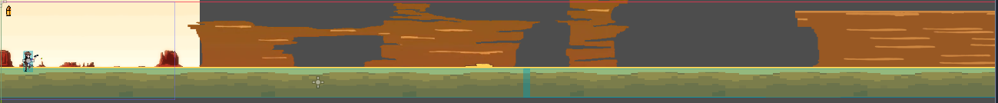
Game Progression
Guns N’ Gobshites

Slide 10
Game Progression
We will have 3 levels which will consist of various enemies confronting Senior H throughout each.The levels become increasingly difficult as our protagonist progresses facing stronger enemies.
Senior H will have 3 hearts denoted by bullets, he will also have 3 lives at the start of each level but if Senior H dies and has no lives left the player must start from the beginning of the game.
Guns N’ Gobshites

Slide 11
Game Progression
Our main character will use his gun to kill the enemies while moving forward and will have the option to venture away from progressing the game to pick up lives and will have to traverse pitfalls by jumping between platforms.
Guns N’ Gobshites

Slide 12
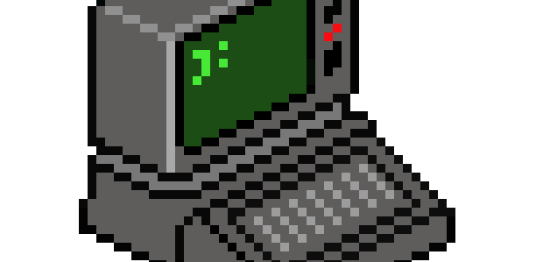
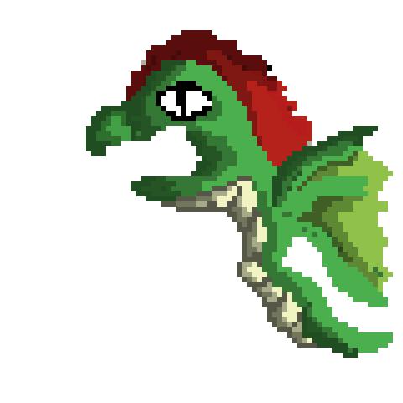
A.I.
Guns N’ Gobshites

Slide 13
A.I.
-All the enemies in our game will utilize some form of artificial intelligence to follow and attack the player. Some of the enemies in our game will be mindless zombies that are itching to get at the player. This enemy is quite simple and only requires basic ai to allow him to function. Other AI fire projectile-based attacks. These types of enemies require more sophisticated ai as they are more difficult to counter.
Guns N’ Gobshites

Slide 14
A.I. Continued
-The main function of the A.I in our game is to ensure the enemies are always a threat. Creating constant stress and pressure to the player making it that much sweeter when the player ends up getting what they want.
Guns N’ Gobshites

Slide 15
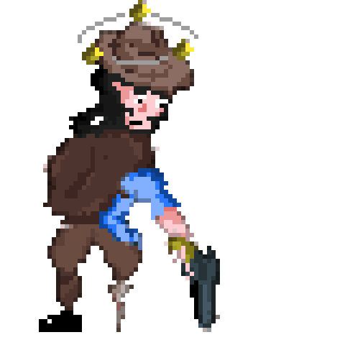
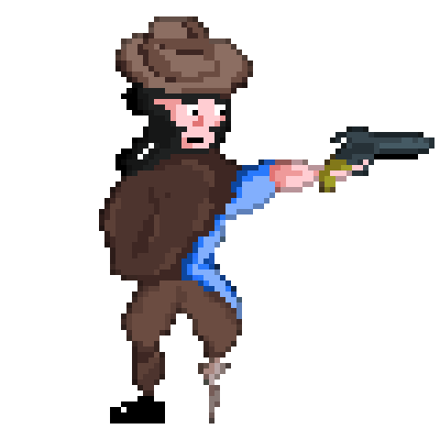

Art, Animation, & GUI
Guns N’ Gobshites

Slide 16
Art & Animation
We will have a variety of characters ranging from a cowboy to fire breathing dragons roaming the sky. Taking our time making every asset from scratch so that the "whacky west" theme of the game can be portrayed correctly. Right now, we have implemented a few of our cast such as our hero and his enemies. All our enemies and animations are going to fit the theme to help the player feel properly immersed in the theme and story of the game.
Guns N’ Gobshites

Slide 17
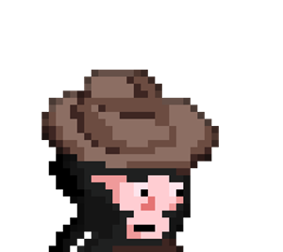
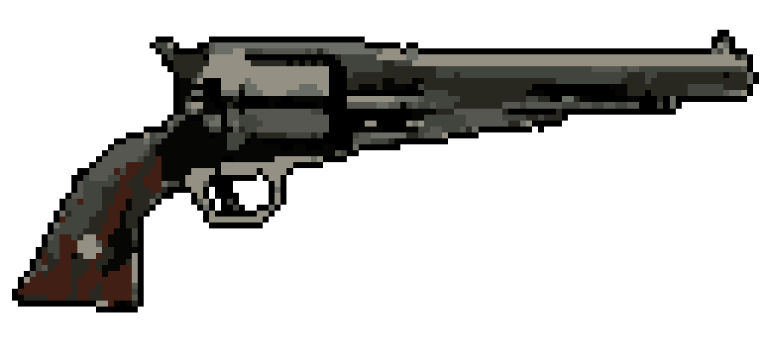
GUI
Relevant information is relayed to the player clearly using a heads-up display. On this HUD the player can clearly see how many lives they have left at any given time, their hit points denoted by bullets as well as the weapon they are using. Certain enemies require more than one hit to kill. It will cause a change in appearance after being hit once.
Guns N’ Gobshites

Slide 18

Level Design & Sound
Guns N’ Gobshites

Slide 19
Sound Design
The game will have a catchy backing track and plan on incorporating our own audio, for the enemy and player gameplay noises. We also intend on having sound effects for all the game elements like gunshots when Senior H fires his gun, noises when enemies are killed, as well as bullet impact noises.
Guns N’ Gobshites

Slide 20
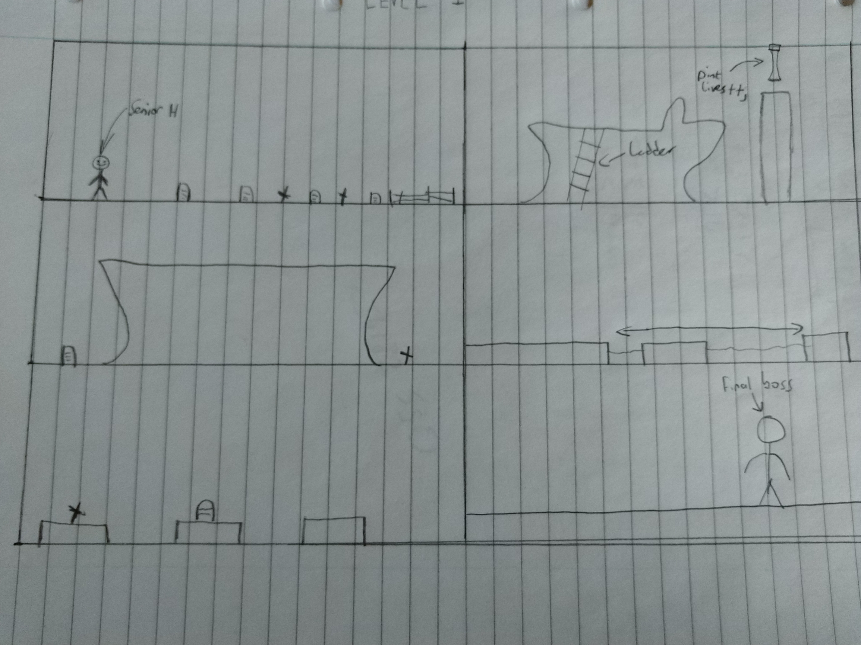
Level Design
Each Level we will make will be split into various sections
Each section of the level should have a new mechanic, enemy or mini-boss and Each level will include previous mechanics
Guns N’ Gobshites

Slide 21
Ending
We plan on having the main character Senior H finally face off against the main villain of the game King Dej.
Once the game has been beaten once, it will allow the player to play the game on higher difficulties.
Beating the game on each difficulty will award the player with a golden pint on the main menus
Guns N’ Gobshites

